Slide 1
Soil moisture monitor with atmospheric data collection
Peter Miller
GEOSC 597
12/8/16

Slide 2
Why do my plants keep dying?

Slide 3
How do I fix this?
I would like to have some way to monitor the moisture content of the soil for my plants.
I Also would like to know the temperature, pressure, humidity and have some way to plot it.
Have some sort of alert for when the soil moisture is below a set value.
THEN WATER!

Slide 4
Solution state machine

Slide 5
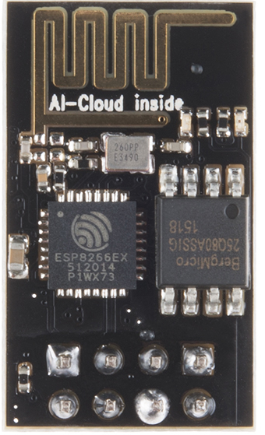
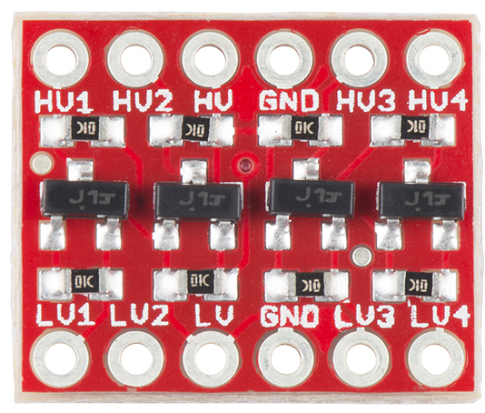
Measurement components
BME280: Atmospheric breakout
ESP8266: Wifi module
Bi-directional logic level converter
Soil moisture sensor
Images from Sparkfun

Slide 6
The hookup
BME-280
Level shifter
WARNING LEDs

Slide 7
The hookup continued…
Soil moisture sensor

Slide 8
Atmospheric data visualization

Slide 9
Soil Moisture

Slide 10
DEMO!!!!

Slide 11
Future work
Consolidate wiring and modules onto a smaller board so that it will fit into a reasonably small waterproof case. The soil moisture sensors are waterproof and so they are able to function in the environment.
Fix the program for WiF connectivity. This is close to working but the issue of programmatically sending serial AT commands needs to be fixed and/or circumvented.
Generate an automated alert system that will either text or email the user when the soil moisture reaches a dangerous level for the plant that is being monitored.

