Slide 1
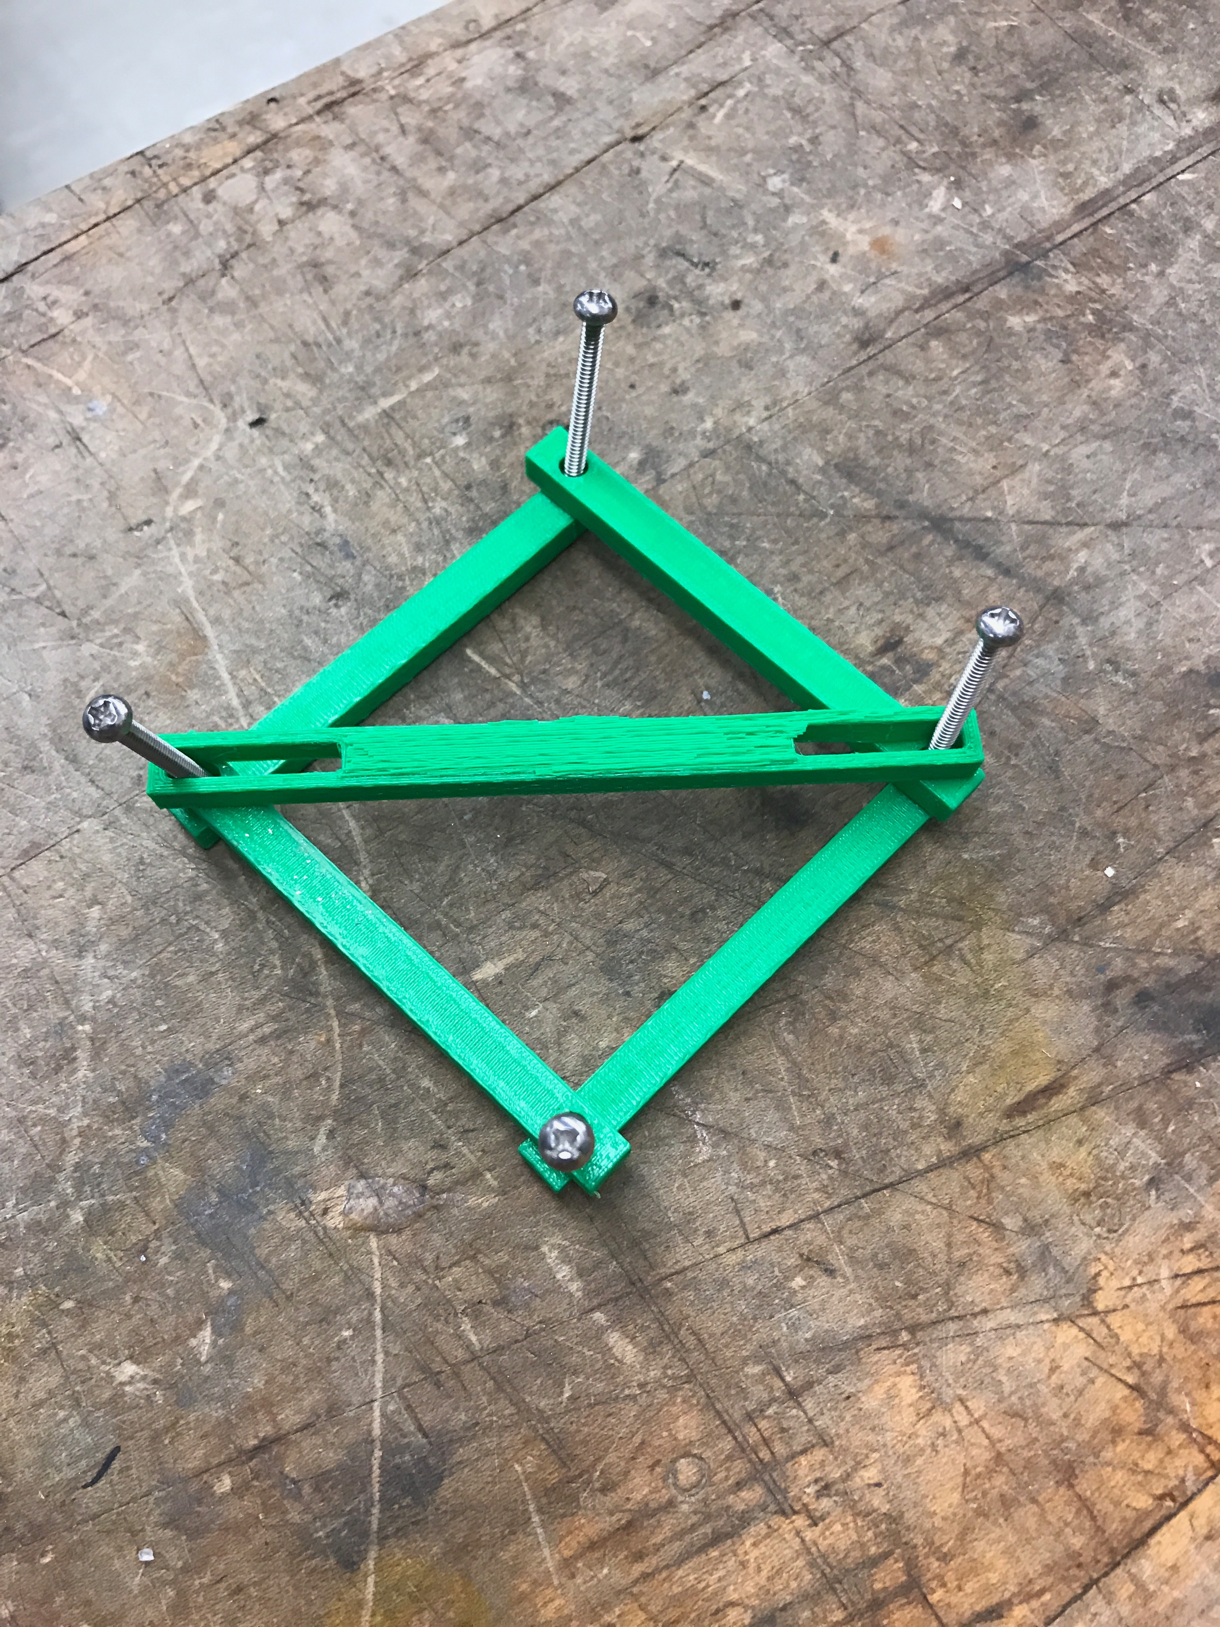
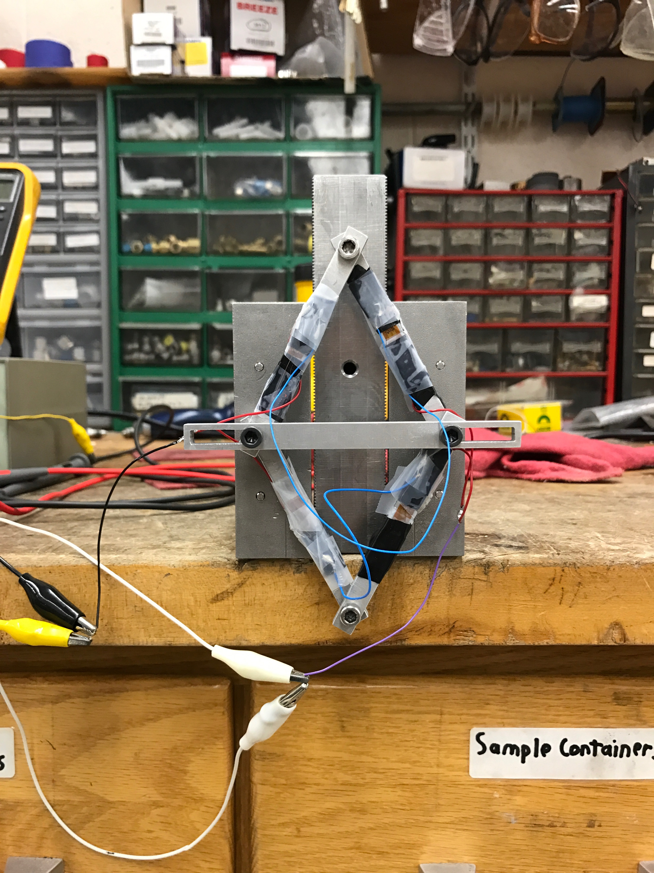
Strain Gauge Displacement Transducer
Geosc597-003
12/8/16
Ben Madara

Slide 2
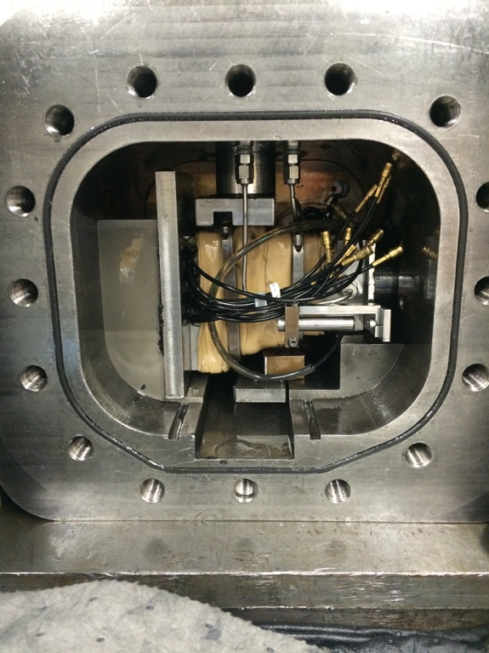
Problem
Indirect measurement
Space limitations

Slide 3
Solution: Strain Gauge Displacement Transducer
Mechanical
3d print for sizing
Diamond shape design to employ Wheatstone bridge
Prototype larger for simplicity
High elastic yield point (aluminum alloy)
Electrical
Wheatstone bridge
Signal amplification
Programming
Record data through Arduino

Slide 4
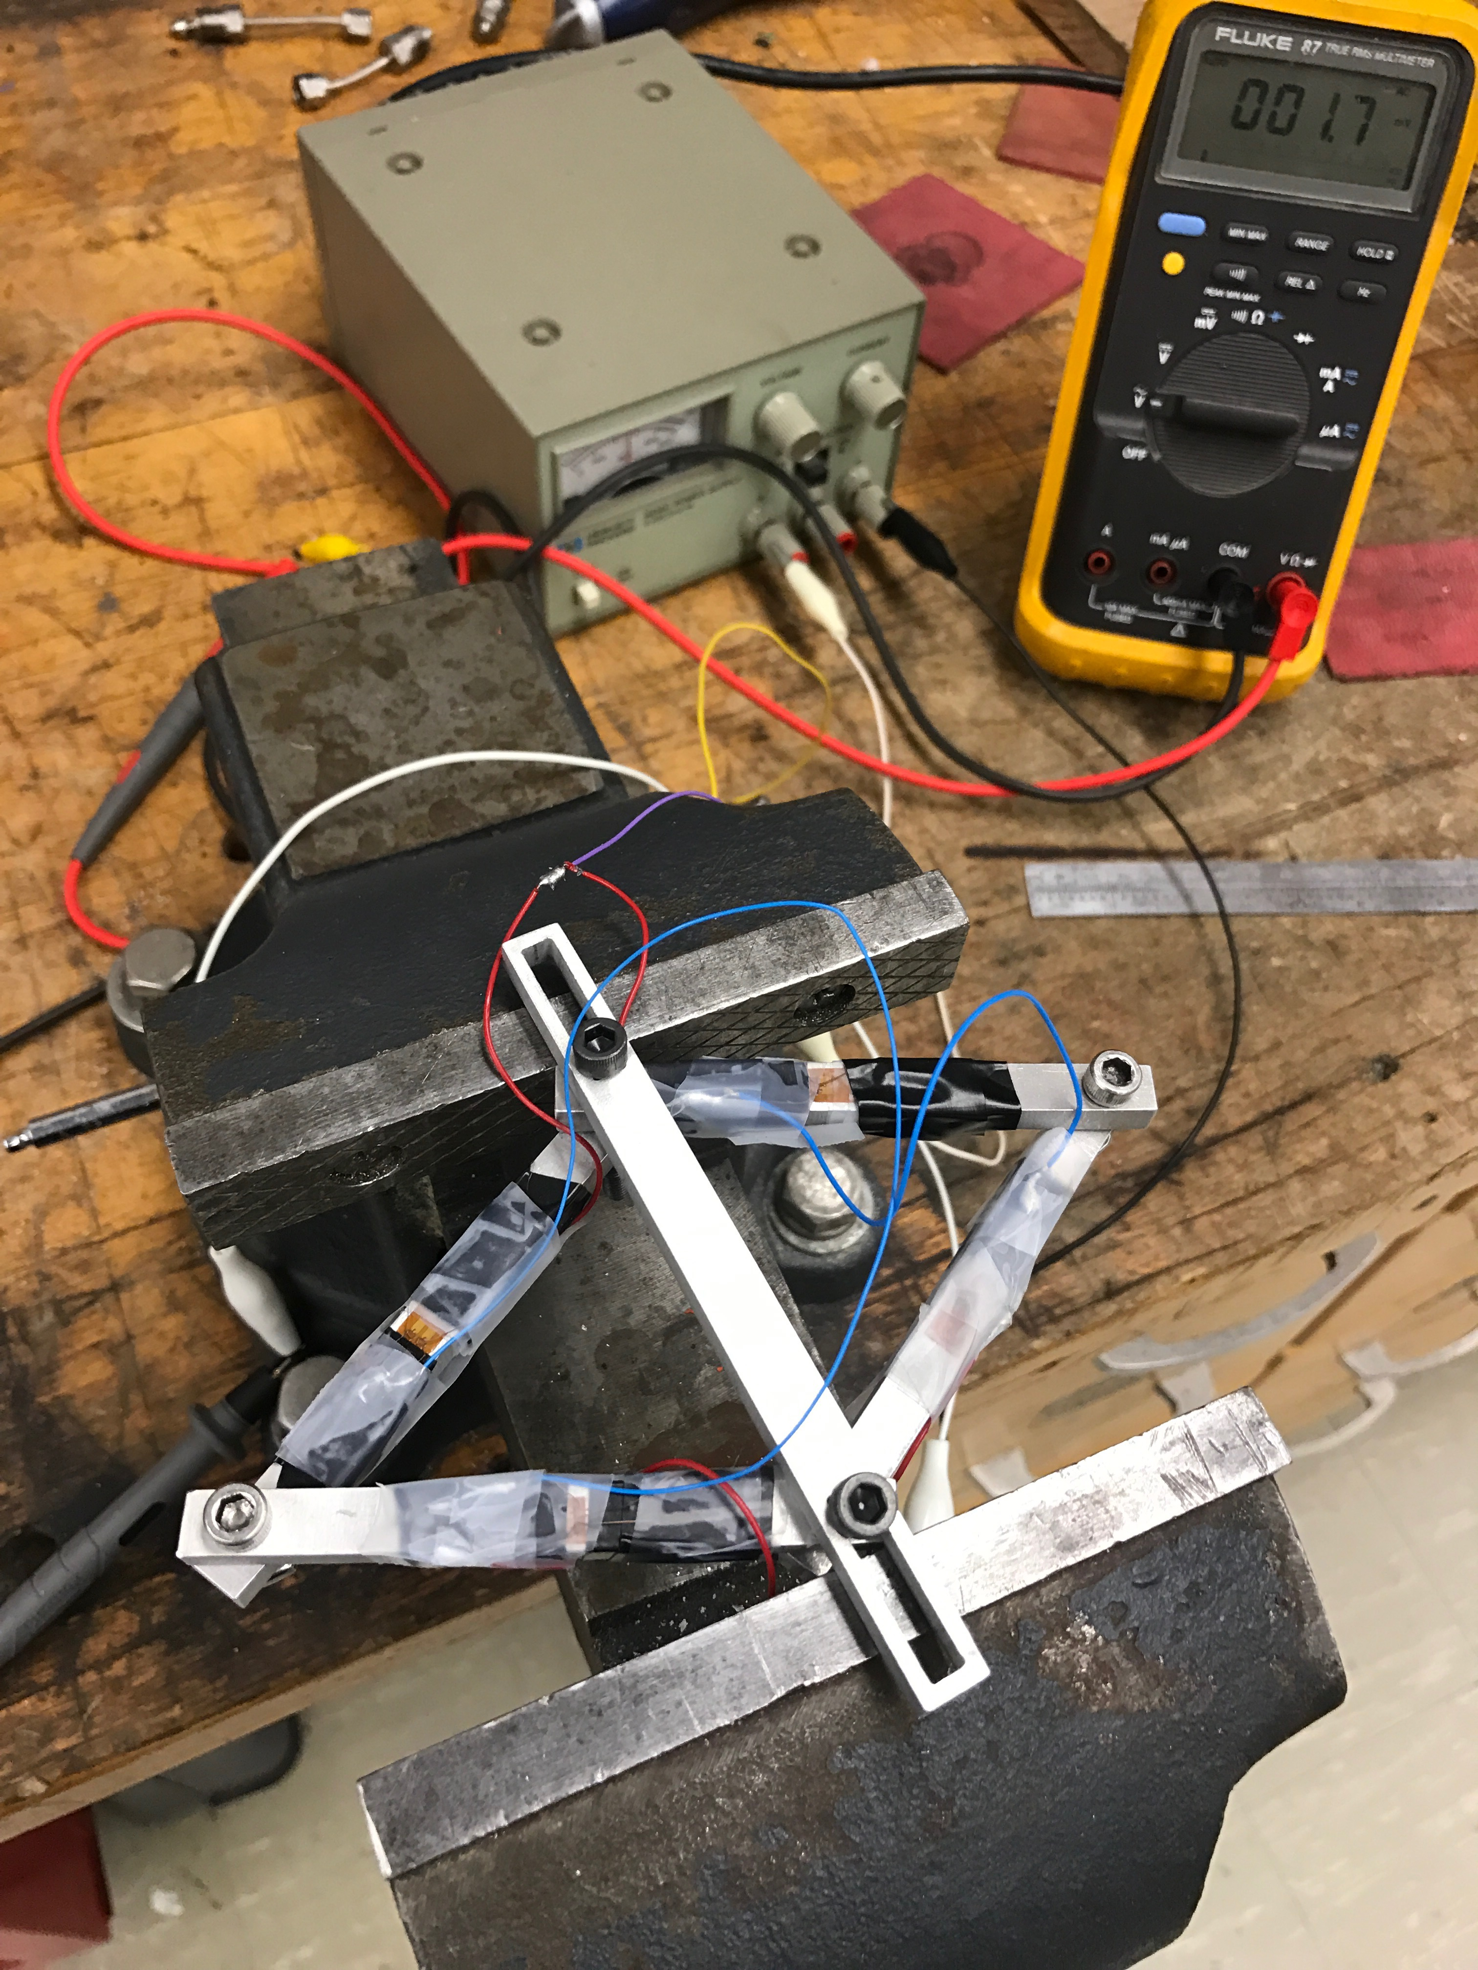
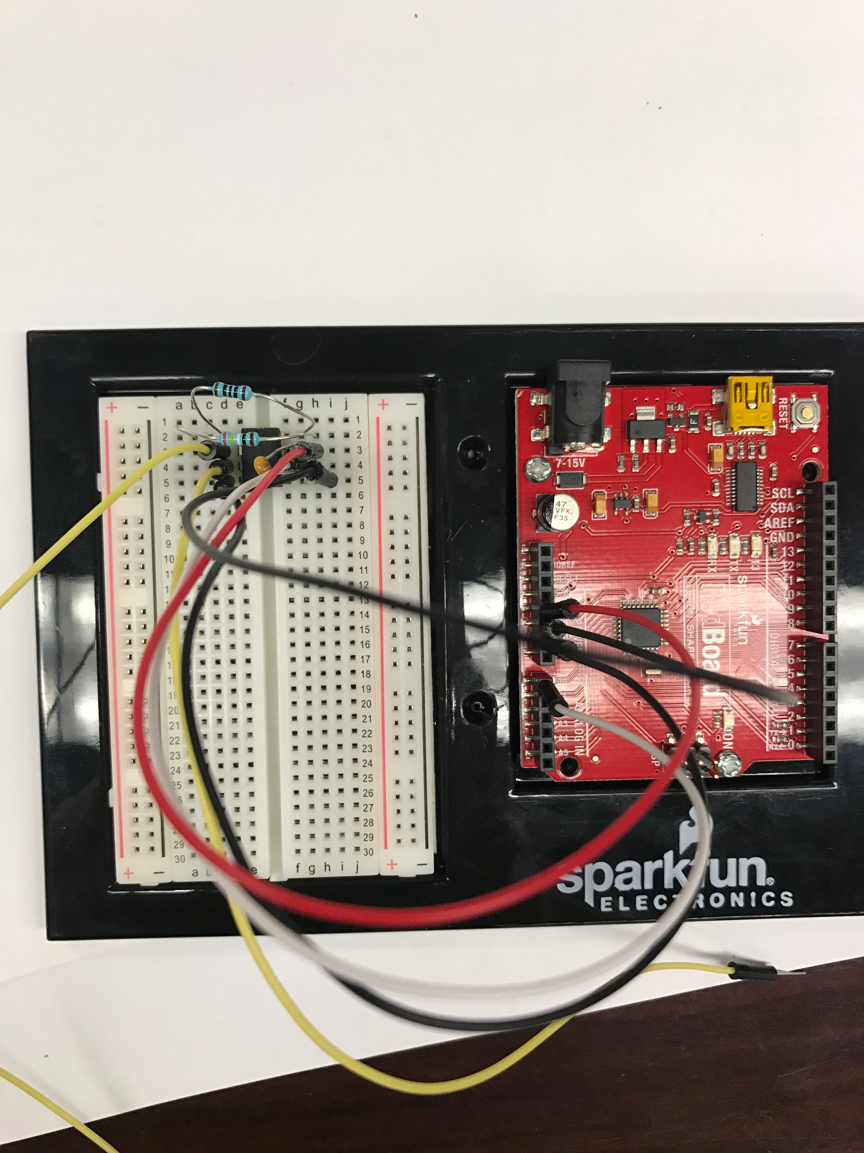
Workflow
3d Print
Bench Test
Programming
Amplifier: INA128
Resistors
Capacitor

Slide 5
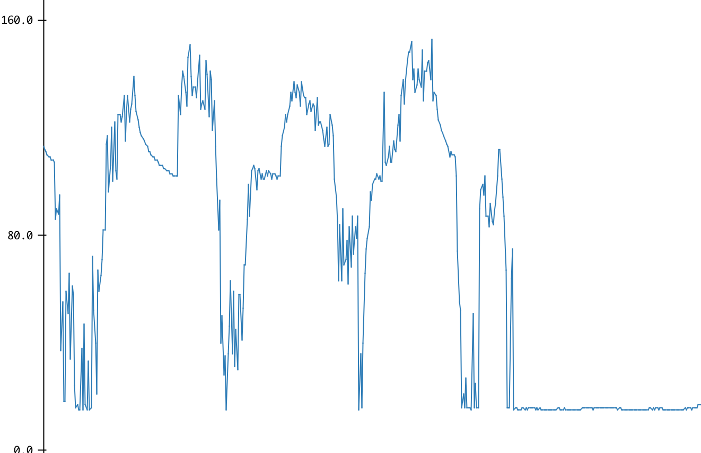
Results

Slide 6
Results/Future Work
Still too noisy for calibration
New strain gauges and amplifiers
Downsize for Pressure Vessel

