Slide 1
Sponge Quake Shear Box
- Stick-slip behavior of unstable patch in stable zone -
Kyungjae Im
Geosc 597-3 Class project - 2016F

Slide 2
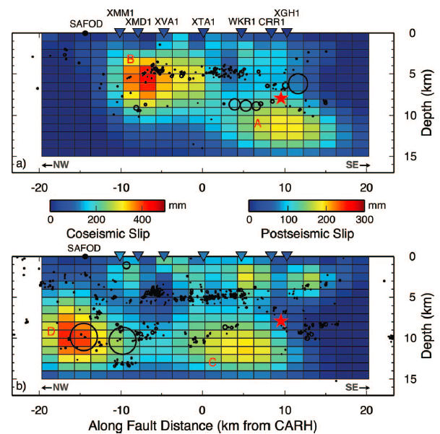
Problem Description
Natural earthquakes are in 3-D
- Critical nucleation length L_{c} ~ G·D_{c}/[(b-a)σ]
- Frictional properties are complexly distributed
Coseismic and postseismic slip of 2004 parkfield earthquake [Johanson et. al. 2006]
Simulation of repeating earthquakes with different
nucleation patch size [Chen et. al. 2010]

Slide 3
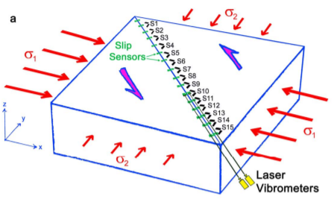
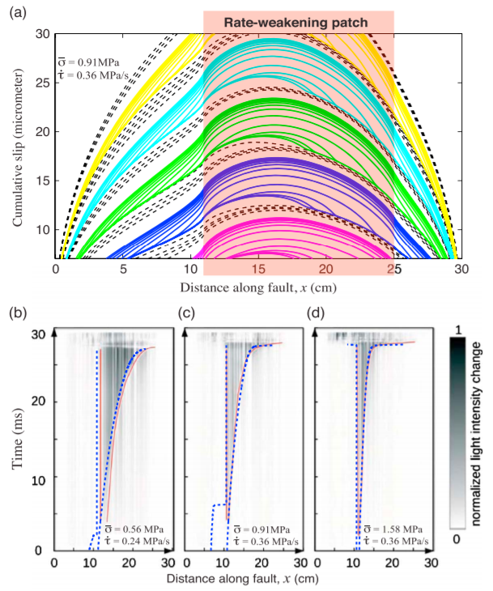
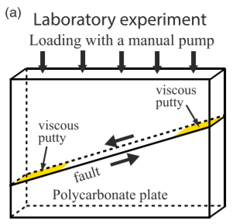
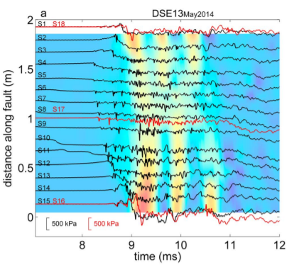
Problem Description
Why laboratory 1+ dimensional slip are difficult? → Rock is too stiff
Large apparatus dimension required
Deformation is tiny
L_{c} ~ G·D_{c}/[(b-a)σ]
(G ~10GPa)
Fault nucleation experiment and simulation with 30cm PMMA
[Latour et. al. 2013, Kaneko et. al 2016]
Rupture propagation experiment with 2m granite
[McLaskey et. al. 2015]

Slide 4
Solution
Soft & Elastic Material

Slide 5
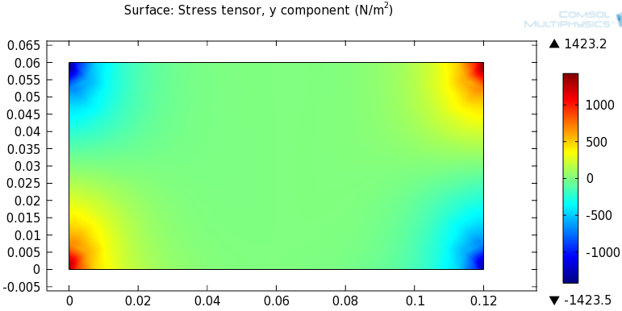
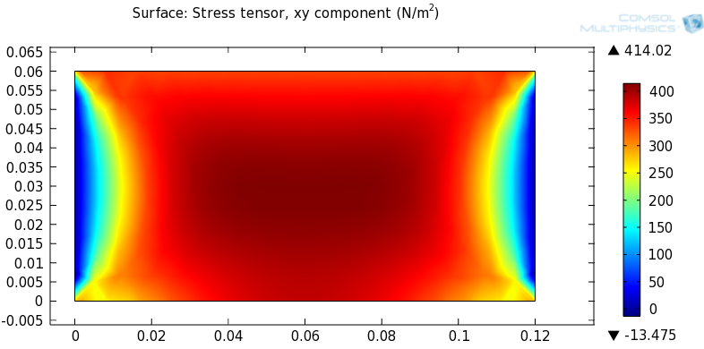
Solution
Solution Requirements
Soft & elastic material
Uniform normal & shear stress distribution
Unstable patch within stable surface
Deformation measurement
Normal and shear stress distribution
with given configuration
Normal force
Shear force
Soft & Elastic Material
deformation measurement
Satble surface (a-b)>0
Satble surface (a-b)>0
Unsatble patch (a-b)<0

Slide 6
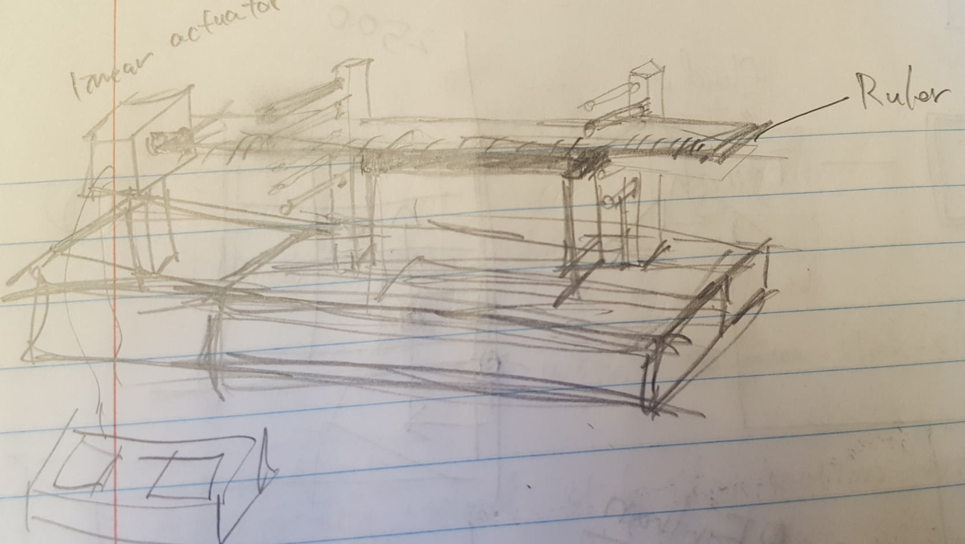
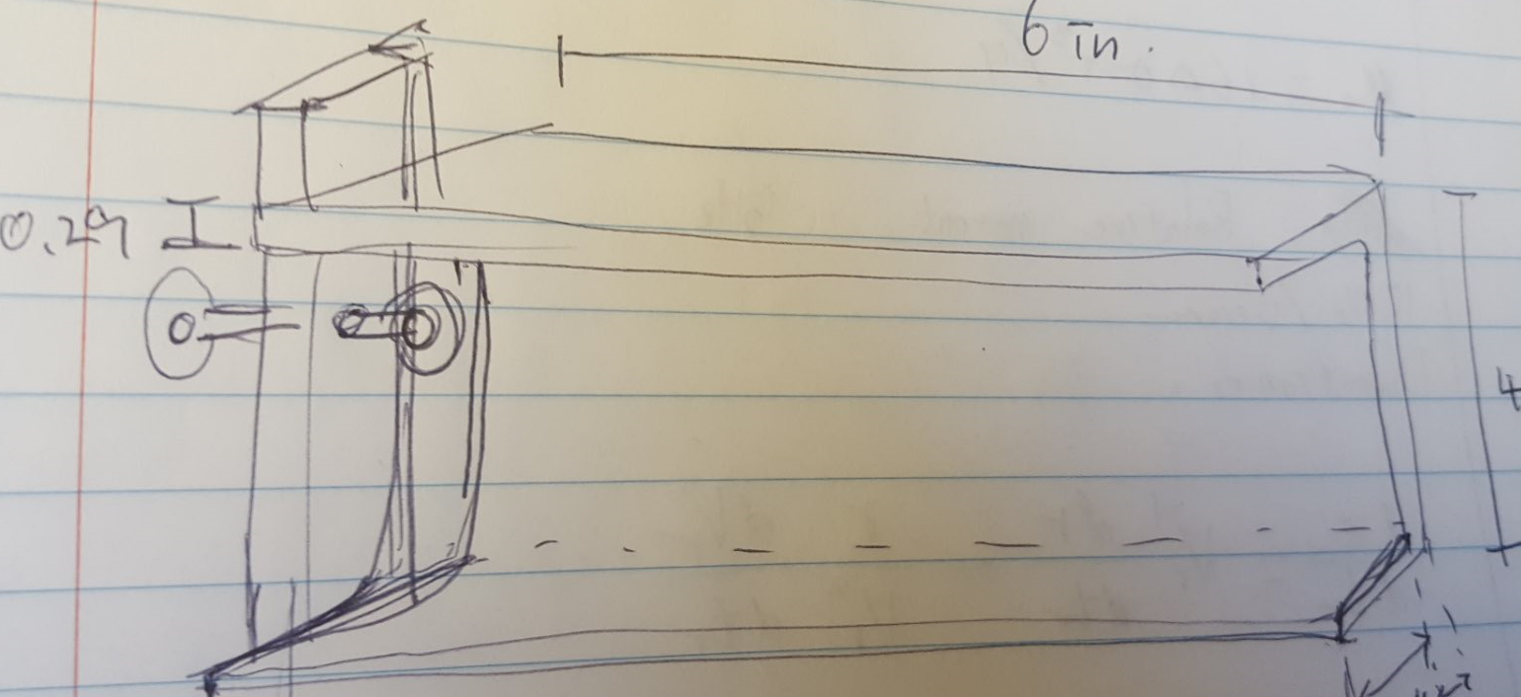
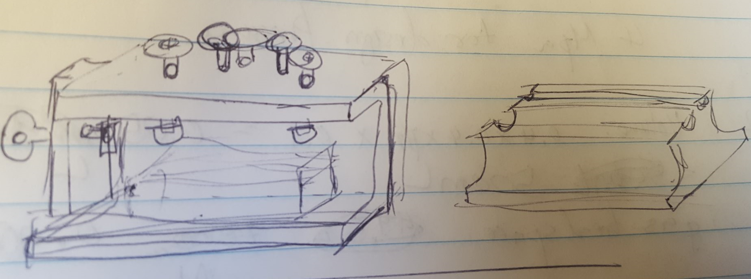
Solution
Mechanical Framework
Some sketches

Slide 7
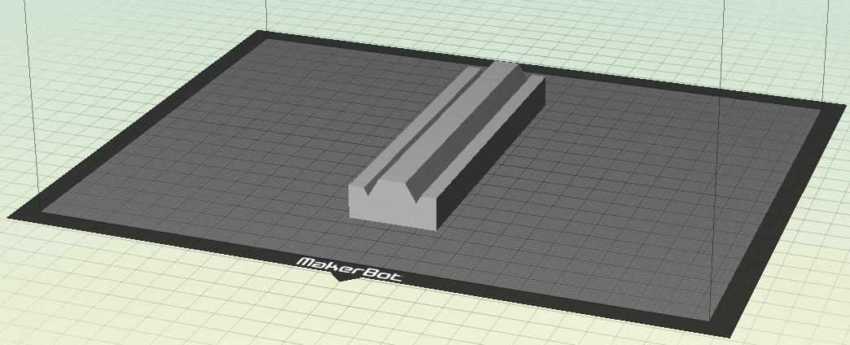
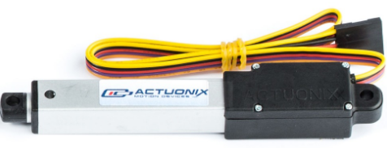
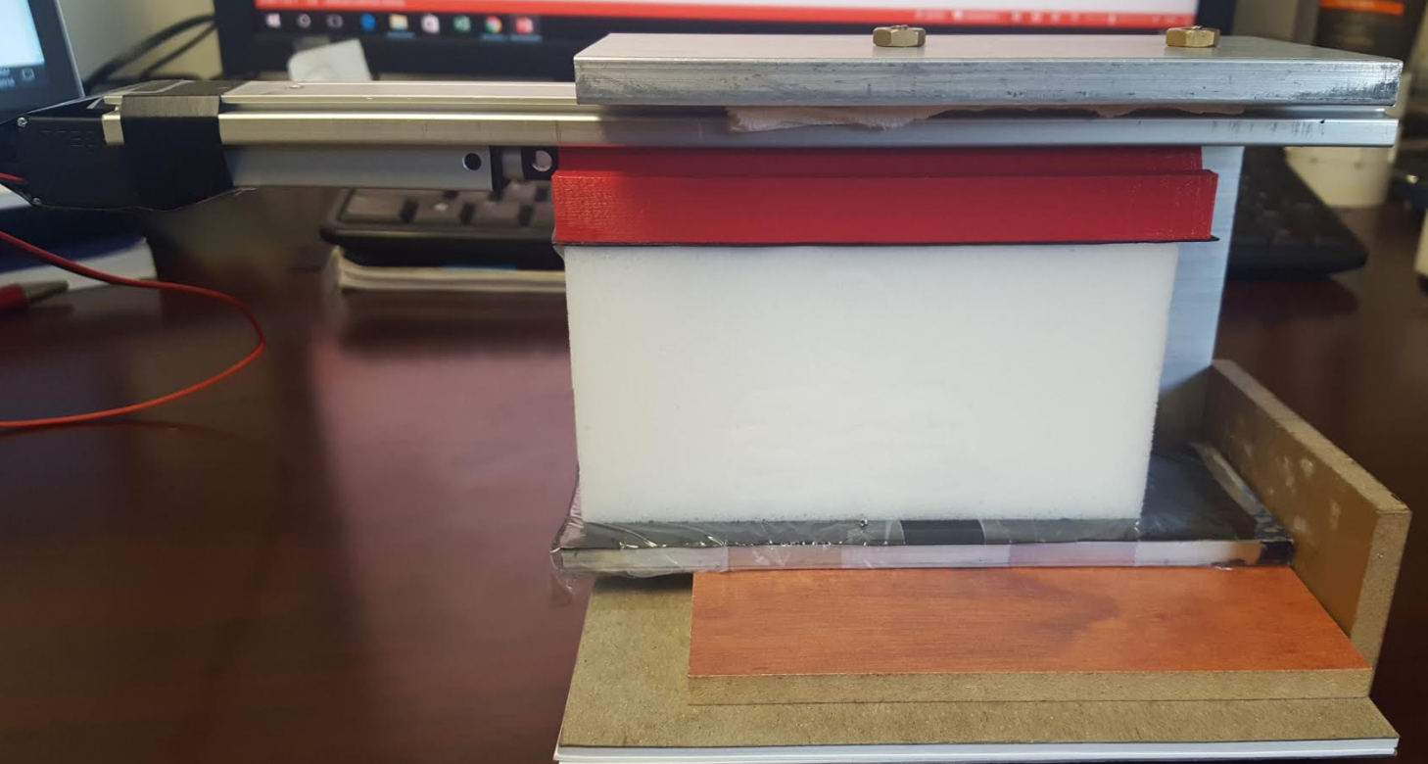
Solution
Final Mechanical Design
Carrige and
slider (3D printed)
Guide Rail
Linear Actuator
Alluminum U-channel frame
Slip surface
Normal stress adjusted with
Inserting thickness pre-measured papers

Slide 8
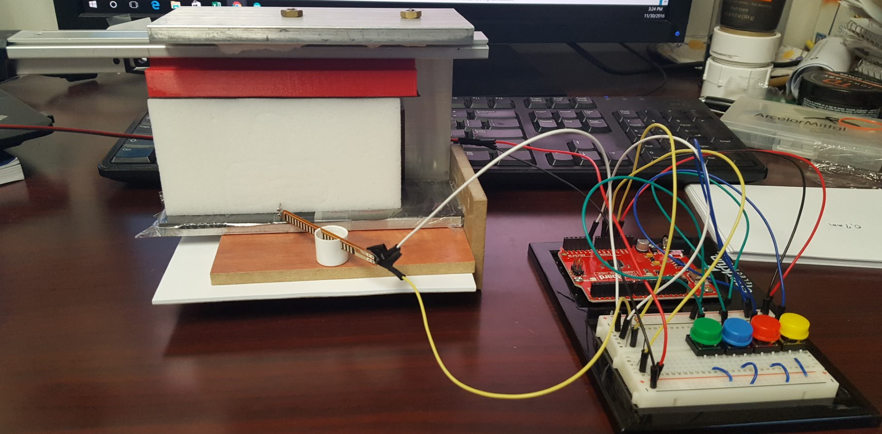
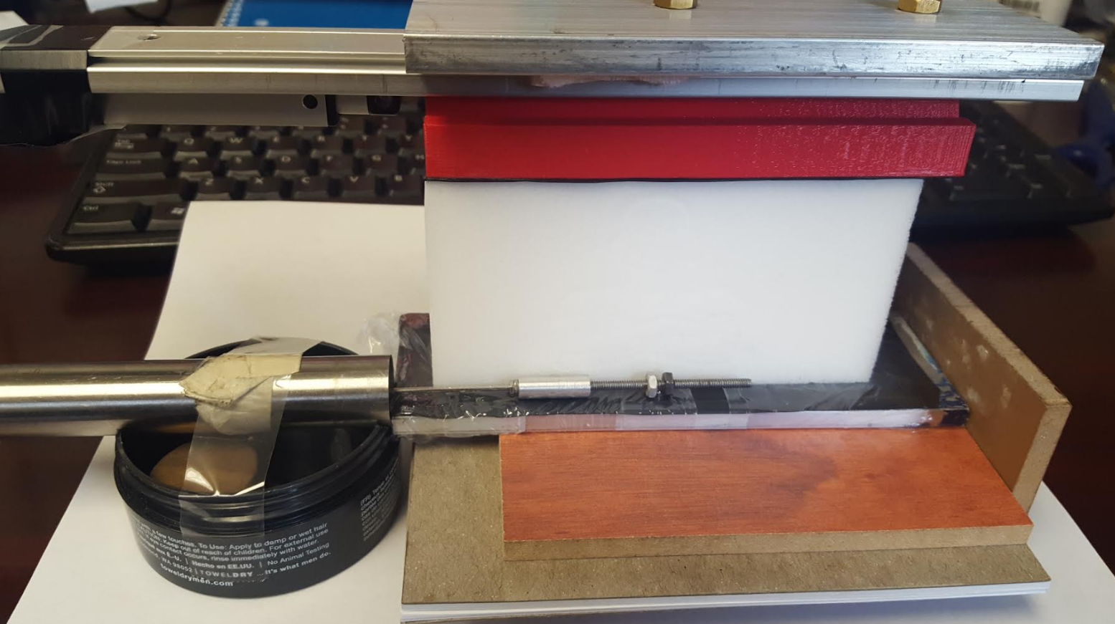
Solution
Measurement
Initial Idea: Flex sensor
But resolution were poor….
Revised Idea: DCDT
pin

Slide 9
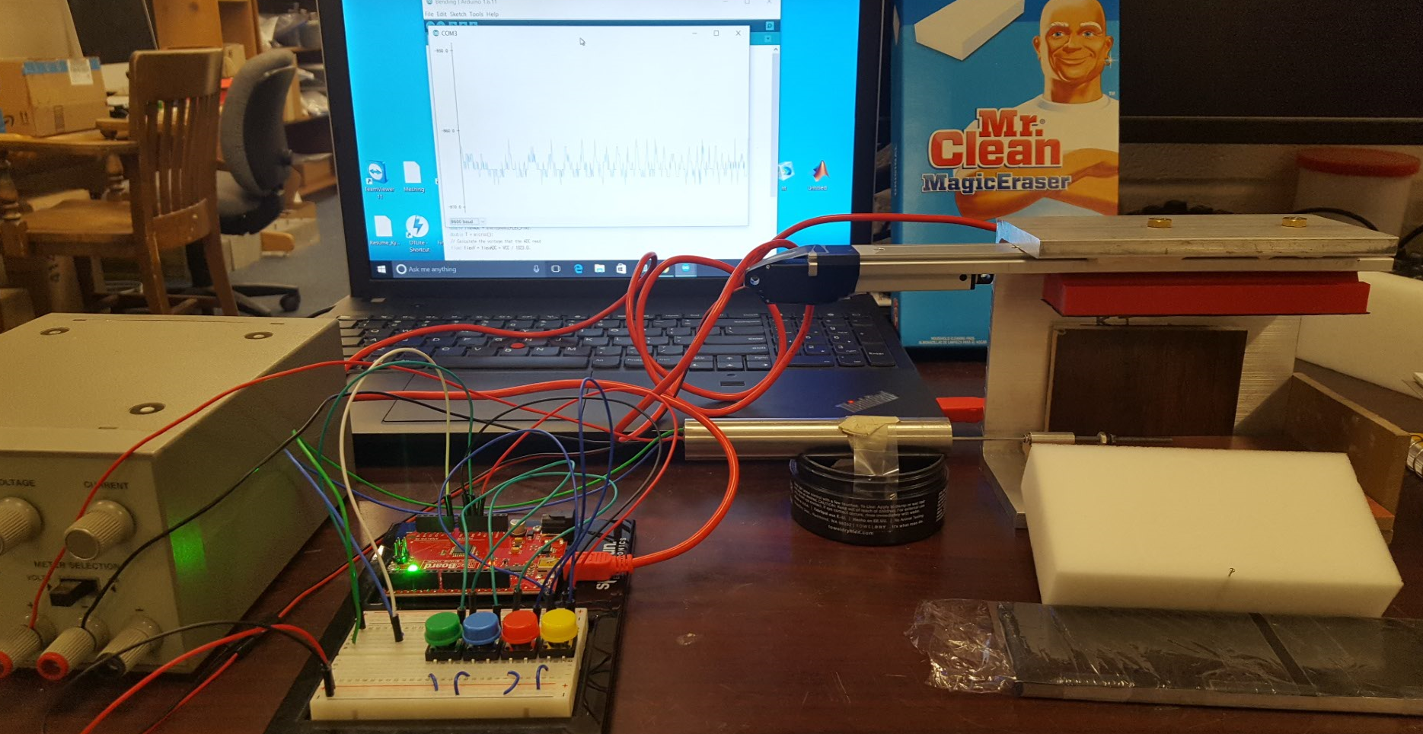
Solution
Electric circuit diagram
Forward operation
Arduino
Linear
Actuator
(Actuonix L12)
+
5V
A0
Output
DCDT
(TRANS-TEK 244)
-
GND
+
-
GND
30V
GND
DC Power
Backward operation

Slide 10
Demonstration

Slide 11
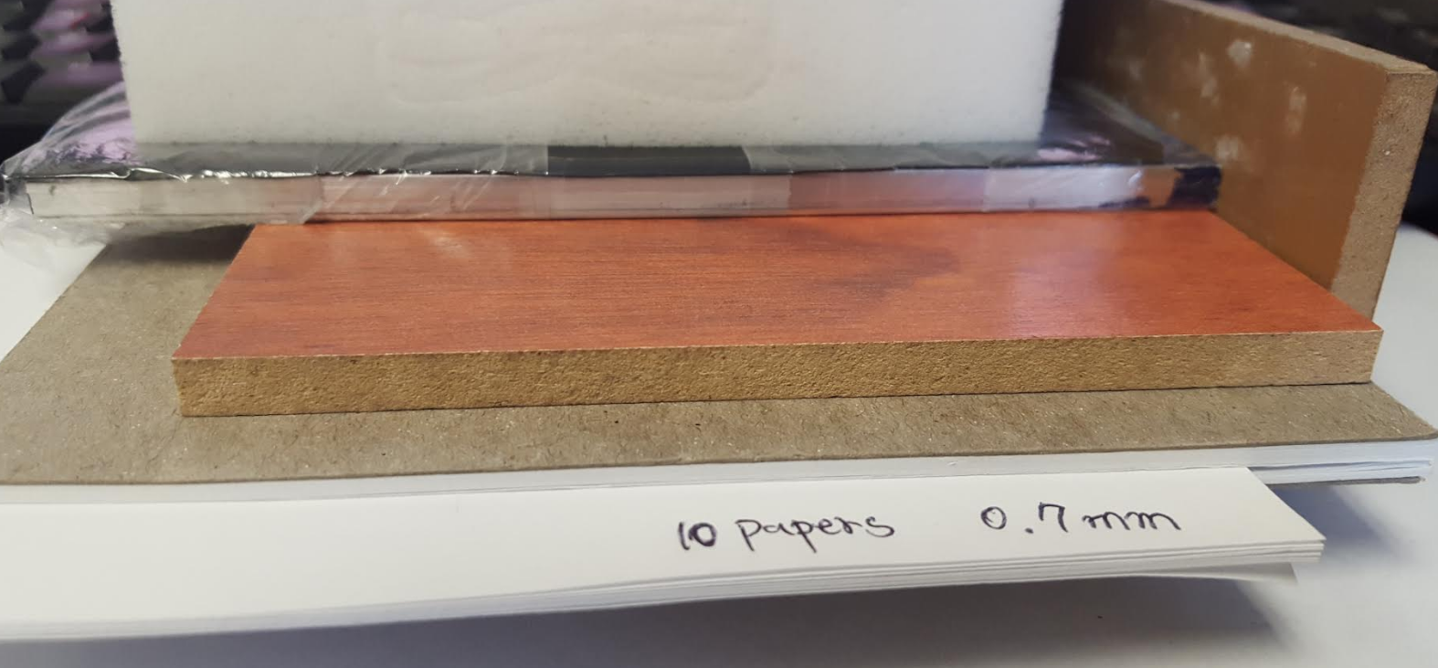
Experimental Setup
12 patch size with 8 Normal stress were tested
Rubber patch size (cm): 0.5, 1.0, 1.5, 2.0, 2.5, 3.0, 3.5, 4.0, 4.5, 5.0, 5.5, 6.0
Normal Force
Paper count | 0 | 10 | 20 | 30 | 40 | 50 | 60 | 70
Normal Force (N) | 1.6 | 4.3 | 7.1 | 9.8 | 12.5 | 15.3 | 18.0 | 20.8
Noarmal Stress (kPa) | 0.5 | 1.3 | 2.2 | 3.0 | 3.9 | 4.7 | 5.6 | 6.4
[1 paper (0.7mm): 2.74 N, Surface Area: 0.12 × 0.27 m²]

Slide 12
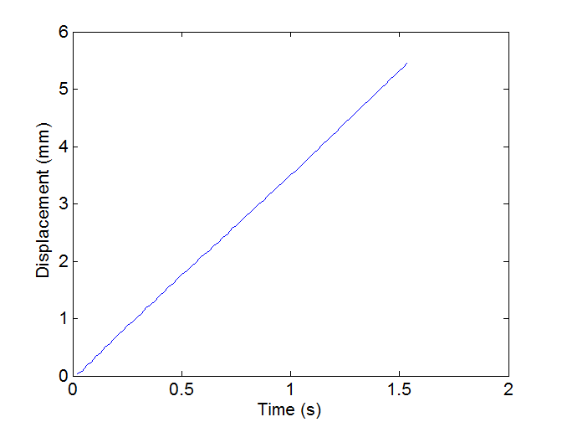
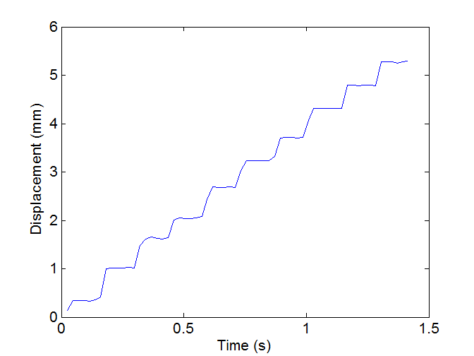
Result
Stable sliding vs. stick slip
2.5cm / 4.3 N
5.0cm / 12.5 N

Slide 13
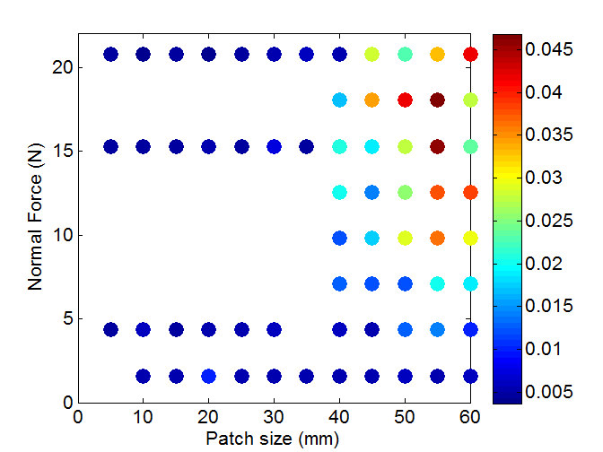
Result
Maximum velocities
Velocity
(m/s)

Slide 14
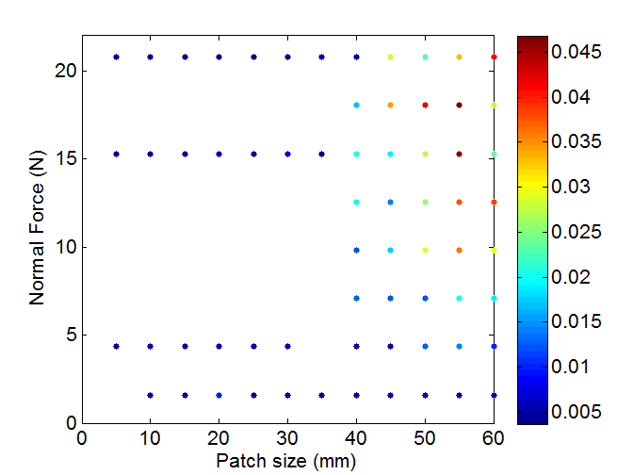
Result
(Apparent) Stability and Discussion
Why not this? (L_{c} ~ 1/σ)
Seem to be solely dependent on patch size?
Velocity
(m/s)
Stable sliding
Stable + unstable
Unstable stick-slip

Slide 15
Problems and Further Upgrade Items
Resolution and sampling interval
- Resolution: ~5μm (Arduino 10 bit 1023 interval with 5.5mm)
- Sampling interval: ~20ms
Longer sponge is required to provide better normal and shear stress condition
Results vari with sponge and surface condition (Sponge stiffness decreases with deformation experience)
Multiple loading velocity is required
Gouge?

Slide 16
Thank You

